Slide 1
Directed Acyclic Graphs
Lecture 26 (Graphs 5)
CS61B, Spring 2024 @ UC Berkeley
Slides credit: Josh Hug
Notes:
Older slides versions with numbered vertices (instead of lettered vertices), if you want to follow along with the web videos: DAG SPT demo

Slide 2
Goals of Today
Today, to practice our problem solving skills, we’ll work through some very challenging A-level problems using the tools we’ve already learned about.
Will focus on graphs, but the ideas today are more general.

Slide 3
Graph Problems So Far
Problem | Problem Description | Solution | Efficiency
paths | Find a path from s to every reachable vertex. | DepthFirstPaths.java Demo | O(V+E) time Θ(V) space
shortest paths | Find the shortest path from s to every reachable vertex. | BreadthFirstPaths.java Demo | O(V+E) time Θ(V) space
shortest weighted paths | Find the shortest path, considering weights, from s to every reachable vertex. | DijkstrasSP.java Demo | O(E log V) time Θ(V) space
shortest weighted path | Find the shortest path, consider weights, from s to some target vertex | A*: Same as Dijkstra’s but with h(v, goal) added to priority of each vertex. Demo | Time depends on heuristic. Θ(V) space

Slide 4
Graph Problems So Far
Problem | Problem Description | Solution | Efficiency
minimum spanning tree | Find a minimum spanning tree. | LazyPrimMST.java Demo | O(???) time Θ(???) space
minimum spanning tree | Find a minimum spanning tree. | PrimMST.java Demo | O(E log V) time Θ(V) space
minimum spanning tree | Find a minimum spanning tree. | KruskalMST.java Demo | O(E log E) time Θ(E) space

Slide 5
Topological Sorting
Topological Sorting
Shortest Paths on DAGs
Longest Paths
Reductions
Definition
Reduction to 3SAT (Optional CS170 Preview)
Lecture 26, CS61B, Spring 2024

Slide 6
Topological Sort
C
A
D
F
B
E
G
H
Suppose we have tasks A through H, where an arrow from v to w indicates that v must happen before w.
What algorithm do we use to find a valid ordering for these tasks?
Valid orderings include: [A, C, B, D, F, E, H, G], [C, A, D, F, B, E, G, H], …

Slide 7
Solution (Spoiler Alert)
C
A
D
F
B
E
G
H
Perform a DFS traversal from every vertex with indegree 0, NOT clearing markings in between traversals.
Record DFS postorder in a list.
Topological ordering is given by the reverse of that list (reverse postorder).

Slide 8
Topological Sort (Demo 1/2)
C
C
C
C
*
A
D
F
A
D
F
A
D
F
A
D
F
*
*
B
E
G
B
E
G
B
E
G
B
E
G
*
H
H
H
H
Postorder: []
Call stack: A
Postorder: []
Call stack: A→B
Postorder: []
Call stack: A→B→E
Postorder: [H]
Call stack: A→B→E→H
C
C
C
C
*
*
A
D
F
A
D
F
A
D
F
A
D
F
*
*
B
E
G
E
G
E
G
B
E
G
B
B
H
H
H
H
Postorder: [H, E]
Call stack: A→B→E
Postorder: [H, E, B]
Call stack: A→B
Postorder: [H, E, B]
Call stack: A
Postorder: [H, E, B, D]
Call stack: A→D

Slide 9
Topological Sort (Demo 2/2)
C
C
*
C
C
*
*
*
A
D
F
A
D
F
A
D
F
A
D
F
E
G
E
G
E
G
B
E
G
B
B
B
H
H
H
H
Postorder: [H, E, B, D]
Call stack: A→D
Postorder: [H, E, B, D, A]
Call stack: A
Postorder: [H, E, B, D, A]
Call stack: C
Postorder: [H, E, B, D, A]
Call stack: C→F
C
C
C
*
A
D
F
A
D
F
*
A
D
F
E
G
*
B
E
G
E
G
B
B
H
H
H
Postorder: [H, E, B, D, A, G]
Call stack: C→F→G
Postorder: [H, E, B, D, A, G, F]
Call stack: C→F
Postorder: [H, E, B, D, A, G, F, C]
Call stack: C

Slide 10
Solution (Spoiler Alert)
C
A
D
F
B
E
G
H
Perform a DFS traversal from every vertex with indegree 0, NOT clearing markings in between traversals.
Record DFS postorder in a list: [H, E, B, D, A, G, F, C]
Topological ordering is given by the reverse of that list (reverse postorder):
[C, F, G, A, D, B, E, H]

Slide 11
Topological Sort
C
A
D
F
C
F
G
A
D
B
E
H
B
E
G
H
The reason it’s called topological sort: Can think of this process as sorting our nodes so they appear in an order consistent with edges, e.g. [C, F, G, A, D, B, E, H]
When nodes are sorted in diagram, arrows all point rightwards.

Slide 12
Depth First Search
Be aware, that when people say “Depth First Search”, they sometimes mean with restarts, and they sometimes mean without.
For example, when we did DepthFirstPaths for reachability, we did not restart.
For Topological Sort, we restarted from every vertex with indegree 0.

Slide 13
Question
What is the runtime to find all vertices of indegree 0?
Interesting thing I did not tell you: You don’t have to.
Another better topological sort algorithm:
Run DFS from an arbitrary vertex.
If not all marked, pick an unmarked vertex and do it again.
Repeat until done.

Slide 14
Test Your Understanding
Give a topological ordering for the graph below (a.k.a. topological sort).
B
6
C
1
2
s
A
4
1
F
2
1
D
3
E

Slide 15
Test Your Understanding
Give a topological ordering for the graph below (a.k.a. topological sort)
A, D, B, C, E, F (because DFS postorder was FECBDA)
B
6
C
1
2
s
A
4
1
F
2
1
Recall that we can think of topological sort as an ordering of “tasks”.
D
3
E
3
s
A
2
D
4
B
6
C
1
E
1
F
1
1
Notes:
SP24 (May 3, 2024) - The edge from A to B was incorrectly marked as weight 2 in the bottom diagram, but has been fixed to be weight 1.

Slide 16
Directed Acyclic Graphs
A topological sort only exists if the graph is a directed acyclic graph (DAG).
For the graph below, there is NO possible ordering where all arrows are respected.
DAGs appear in many real world applications, and there are many graph algorithms that only work on DAGs.
C
A
D
F
B
E
G
H

Slide 17
Graph Problems
Problem | Problem Description | Solution | Efficiency
topological sort | Find an ordering of vertices that respects edges of our DAG. | Demo Topological.java | O(V+E) time Θ(V) space

Slide 18
Shortest Paths on DAGs
Topological Sorting
Shortest Paths on DAGs
Longest Paths
Reductions
Definition
Reduction to 3SAT (Optional CS170 Preview)
Lecture 26, CS61B, Spring 2024

Slide 19
Shortest Paths Warmup
What is the shortest paths tree for the graph below, using s as the source? In what order will Dijkstra’s algorithm visit the vertices?
B
6
C
1
2
s
A
4
1
F
2
1
D
3
E
Graph from Algorithms, by Vazirani/Papadimitriou

Slide 20
Shortest Paths Warmup
What is the shortest paths tree for the graph below, using s as the source? In what order will Dijkstra’s algorithm visit the vertices?
A, B, D, E, F, C
1
7
B
6
C
1
2
6
s
A
4
1
F
2
1
D
3
E
2
5

Slide 21
Shortest Paths Warmup
If we allow negative edges, Dijkstra’s algorithm can fail.
For example, below we see Dijkstra’s just before vertex C is visited.
1
7
B
6
C
1
1
3
s
A
25
-20
F
1
1
D
1
E
1
2
Notes:
FA23: An older version of this slide (before the FA23 live lecture) incorrectly wrote "vertex 2," when it should say "vertex C". (We changed the vertex labels from numbers to letters, but forgot to update the text of the slide.)

Slide 22
Shortest Paths Warmup
If we allow negative edges, Dijkstra’s algorithm can fail.
For example, below we see Dijkstra’s just before vertex C is visited.
Relaxation on E succeeds, but distance to F will never be updated.
1
7
B
6
C
1
1
3
s
A
25
-20
F
1
1
D
1
E
1
2
-13
Notes:
FA23: An older version of this slide (before the FA23 live lecture) incorrectly wrote "vertex 2", "relaxation on 4", and "distance to 5", when it should say "vertex C", "relaxation on E", and "distance to F". (We changed the vertex labels from numbers to letters, but forgot to update the text of the slide.)

Slide 23
Shortest Paths Warmup
If we allow negative edges, Dijkstra’s algorithm can fail.
For example, below we see Dijkstra’s just before vertex C is visited.
Relaxation on E succeeds, but distance to F will never be updated.
1
7
B
6
C
distTo is wrong!
1
1
3
s
A
25
-20
F
1
1
D
1
E
1
-13
Notes:
FA23: An older version of this slide (before the FA23 live lecture) incorrectly wrote "vertex 2", "relaxation on 4", and "distance to 5", when it should say "vertex C", "relaxation on E", and "distance to F". (We changed the vertex labels from numbers to letters, but forgot to update the text of the slide.)

Slide 24
Challenge
Try to come up with an algorithm for shortest paths on a DAG that works even if there are negative edges.
Hint: You should still use the “relax” operation as a basic building block.
∞
∞
B
6
C
1
1
∞
s
A
25
-20
F
1
1
D
1
E
∞
∞

Slide 25
Challenge
Try to come up with an algorithm for shortest paths on a DAG that works even if there are negative edges.
Hint: You should still use the “relax” operation as a basic building block.
∞
∞
B
6
C
1
1
∞
s
A
25
-20
F
1
1
D
1
E
∞
∞
One simple idea: Visit vertices in topological order.
On each visit, relax all outgoing edges.
Each vertex is visited only when all possible info about it has been used!

Slide 26
The DAG SPT Algorithm: Relax in Topological Order
First: We have to find a topological order, e.g. ADBCEF. Runtime is O(V + E).
∞
∞
B
6
C
1
1
∞
s
A
25
-20
F
1
1
D
1
E
∞
∞
1
s
A
1
D
1
B
6
C
-20
E
1
F
1
1
Notes:
FA23: An older version of this slide (before the FA23 live lecture) incorrectly wrote "031245", when it should say "ADBCEF". (We changed the vertex labels from numbers to letters, but forgot to update the text of the slide.)

Slide 27
The DAG SPT Algorithm: Relax in Topological Order
Second: We have to visit all the vertices in topological order, relaxing all edges as we go. Let’s see a demo.
1
s
A
1
D
1
B
6
C
-20
E
1
F
1
1

Slide 28
DAG SPT Algorithm
Visit vertices in topological order.
When we visit a vertex: relax all of its going edges.
distTo edgeTo
A 0 -
B ∞ -
C ∞ -
D ∞ -
E ∞ -
F ∞ -
1
0
∞
∞
∞
∞
∞
s
A
D
B
6
C
E
1
F
1
1
-20
1
1
Fringe: [A, D, B, C, E, F]

Slide 29
DAG SPT Algorithm
Visit vertices in topological order.
When we visit a vertex: relax all of its going edges.
distTo edgeTo
A 0 -
B ∞ -
C ∞ -
D ∞ -
E ∞ -
F ∞ -
1
0
∞
∞
∞
∞
∞
s
A
D
B
6
C
D
1
F
1
1
-20
1
1
Fringe: [A, D, B, C, E, F]

Slide 30
DAG SPT Algorithm
Visit vertices in topological order.
When we visit a vertex: relax all of its going edges.
distTo edgeTo
A 0 -
B 1 A
C ∞ -
D 1 A
E ∞ -
F ∞ -
1
1
1
0
∞
∞
∞
∞
∞
s
A
D
B
6
C
E
1
F
1
1
-20
1
1
Fringe: [A, D, B, C, E, F]

Slide 31
DAG SPT Algorithm
Visit vertices in topological order.
When we visit a vertex: relax all of its going edges.
distTo edgeTo
A 0 -
B 1 A
C ∞ -
D 1 A
E ∞ -
F ∞ -
1
0
1
1
∞
∞
∞
s
A
D
B
6
C
E
1
F
1
1
-20
1
1
Fringe: [A, D, B, C, E, F]

Slide 32
DAG SPT Algorithm
Visit vertices in topological order.
When we visit a vertex: relax all of its going edges.
distTo edgeTo
A 0 -
B 1 A
C ∞ -
D 1 A
E 2 D
F ∞ -
1
2
0
1
1
∞
∞
∞
s
A
D
B
6
C
E
1
F
1
1
-20
1
1
Fringe: [A, D, B, C, E, F]

Slide 33
DAG SPT Algorithm
Visit vertices in topological order.
When we visit a vertex: relax all of its going edges.
distTo edgeTo
A 0 -
B 1 A
C ∞ -
D 1 A
E 2 D
F ∞ -
1
0
1
1
∞
2
∞
s
A
D
B
6
C
E
1
F
1
1
-20
1
1
Fringe: [A, D, B, C, E, F]

Slide 34
DAG SPT Algorithm
Visit vertices in topological order.
When we visit a vertex: relax all of its going edges.
distTo edgeTo
A 0 -
B 1 A
C 7 B
D 1 A
E 2 D
F ∞ -
1
0
7
∞
1
1
∞
2
s
A
D
B
6
C
E
1
F
1
1
-20
1
1
Fringe: [A, D, B, C, E, F]

Slide 35
DAG SPT Algorithm
Visit vertices in topological order.
When we visit a vertex: relax all of its going edges.
distTo edgeTo
A 0 -
B 1 A
C 7 B
D 1 A
E 2 D
F ∞ -
1
0
1
1
7
2
∞
s
A
D
B
6
C
E
1
F
1
1
-20
1
1
Fringe: [A, D, B, C, E, F]

Slide 36
DAG SPT Algorithm
Visit vertices in topological order.
When we visit a vertex: relax all of its going edges.
distTo edgeTo
A 0 -
B 1 A
C 7 B
D 1 A
E -13 C
F ∞ -
1
-13
8
0
1
1
7
2
∞
s
A
D
B
6
C
E
1
F
1
1
-20
1
1
Fringe: [A, D, B, C, E, F]

Slide 37
DAG SPT Algorithm
Visit vertices in topological order.
When we visit a vertex: relax all of its going edges.
distTo edgeTo
A 0 -
B 1 A
C 7 B
D 1 A
E -13 C
F ∞ -
1
0
1
1
7
-13
8
s
A
D
B
6
C
E
1
F
1
1
-20
1
1
Fringe: [A, D, B, C, E, F]

Slide 38
DAG SPT Algorithm
Visit vertices in topological order.
When we visit a vertex: relax all of its going edges.
distTo edgeTo
A 0 -
B 1 A
C 7 B
D 1 A
E -13 C
F -12 E
1
-12
0
1
1
7
-13
∞
s
A
D
B
6
C
E
1
F
1
1
-20
1
1
Fringe: [A, D, B, C, E, F]

Slide 39
DAG SPT Algorithm
Visit vertices in topological order.
When we visit a vertex: relax all of its going edges.
distTo edgeTo
A 0 -
B 1 A
C 7 B
D 1 A
E -13 C
F -12 E
1
0
1
1
7
-13
-12
s
A
D
B
6
C
E
1
F
1
1
-20
1
1
Fringe: [A, D, B, C, E, F]

Slide 40
The DAG SPT Algorithm: Relax in Topological Order
Second: We have to visit all the vertices in topological order, relaxing all edges as we go.
Runtime for step 2 is also O(V + E).
Occasional question: why isn’t it O(V*E)? We’re relaxing all edges from each vertex.
Keep in mind that E is the total number of edges in the entire graph, not the number of edges per vertex. Example: for the graph below, E = 8.
1
s
A
1
D
1
B
6
C
-20
E
1
F
1
1

Slide 41
Graph Problems
Problem | Problem Description | Solution | Efficiency
topological sort | Find an ordering of vertices that respects edges of our DAG. | Demo Code: Topological.java | O(V+E) time Θ(V) space
DAG shortest paths | Find a shortest paths tree on a DAG. | Demo Code: AcyclicSP.java | O(V+E) time Θ(V) space
Note: The DAG shortest paths solution uses the topological sort solution as a subroutine.

Slide 42
Longest Paths
Topological Sorting
Shortest Paths on DAGs
Longest Paths
Reductions
Definition
Reduction to 3SAT (Optional CS170 Preview)
Lecture 26, CS61B, Spring 2024

Slide 43
The Longest Paths Problem
Consider the problem of finding the longest path tree (LPT) from s to every other vertex. The path must be simple (no cycles!).
D
11
B
1
2
2
3
G
5
E
5
s
A
1
1
4
1
C
15
F

Slide 44
The Longest Paths Problem
Consider the problem of finding the longest path tree (LPT) from s to every other vertex. The path must be simple (no cycles!).
Some surprising facts:
Best known algorithm is exponential (extremely bad).
Perhaps the most important unsolved problem in mathematics.
D
13
2
11
B
1
2
20
2
3
15
G
5
E
5
s
A
1
7
1
4
1
C
22
15
F
Two potentially interesting exercises after lecture:
Find an example where the obvious algorithm (Dijkstra’s but pick the biggest edge first) fails.
Figure out: Is the longest path to every other vertex always a tree (i.e. does an LPT exist for all graphs)?

Slide 45
The Longest Paths Problem on DAGs
Difficult challenge for you.
Solve the LPT problem on a directed acyclic graph.
Algorithm must be O(E + V) runtime.
6
12
B
6
C
0
1
2
14
s
A
4
1
F
2
1
D
3
E
2
13

Slide 46
The Longest Paths Problem on DAGs
DAG LPT solution for graph G:
Form a new copy of the graph G’ with signs of all edge weights flipped.
Run DAGSPT on G’ yielding result X.
Flip signs of all values in X.distTo. X.edgeTo is already correct.
-6
-12
B
-6
C
0
-1
-2
-14
s
A
-4
-1
F
-2
-1
D
-3
E
-2
-13
Notes:
FA23: An older version of this slide (before the FA23 live lecture) incorrectly showed the distance to B (magenta number) as -1, when it should be -6.

Slide 47
The Longest Paths Problem on DAGs
DAG LPT solution for graph G:
Form a new copy of the graph G’ with signs of all edge weights flipped.
Run DAGSPT on G’ yielding result X.
Flip signs of all values in X.distTo. X.edgeTo is already correct.
6
12
B
C
0
14
s
A
F
D
E
2
13
Notes:
FA23: An older version of this slide (before the FA23 live lecture) incorrectly showed the distance to B (magenta number) as 1, when it should be 6.

Slide 48
A Note on “Mathematical Maturity”
If you have a very high degree of so-called “mathematical maturity”, this algorithm should seem plainly correct.
There’s no real need to prove anything or show demos.
We know DAG SPT works on graphs with negative edge weights.
We also know that -(-a + -b + -c + -d) = a + b + c + d.
Part of what you’re learning in your intense technical education here at Berkeley is mathematical maturity. Hasn’t been a major focus in 61B, but will be in other courses like 16A, 16B, 70, 170, ...

Slide 49
Highly Recommended Exercise For Later
Play around with the longest paths problem and convince yourself that it is actually very hard.
Try to develop an intuition for why it is hard. Even better if you try to put it into english.
Try searching the internet for “why longest paths hard” or similar if you’re having trouble really pinning down what’s so hard about it.

Slide 50
Graph Problems
Problem | Problem Description | Solution | Efficiency
topological sort | Find an ordering of vertices that respects edges of our DAG. | Demo Code: Topological.java | O(V+E) time Θ(V) space
DAG shortest paths | Find a shortest paths tree on a DAG. | Demo Code: AcyclicSP.java | O(V+E) time Θ(V) space
longest paths | Find a longest paths tree on a graph. | No known efficient solution. | O(???) time O(???) space
DAG longest paths | Find a longest paths tree on a DAG. | Flip signs, run DAG SPT, flip signs again. | O(V+E) time Θ(V) space

Slide 51
Reductions: Definition
Topological Sorting
Shortest Paths on DAGs
Longest Paths
Reductions
Definition
Reduction to 3SAT (Optional CS170 Preview)
Lecture 26, CS61B, Spring 2024

Slide 52
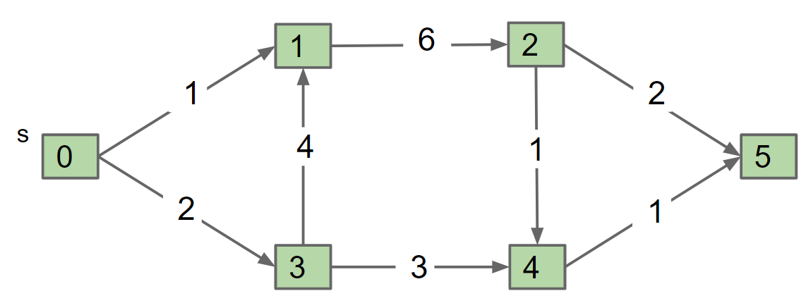
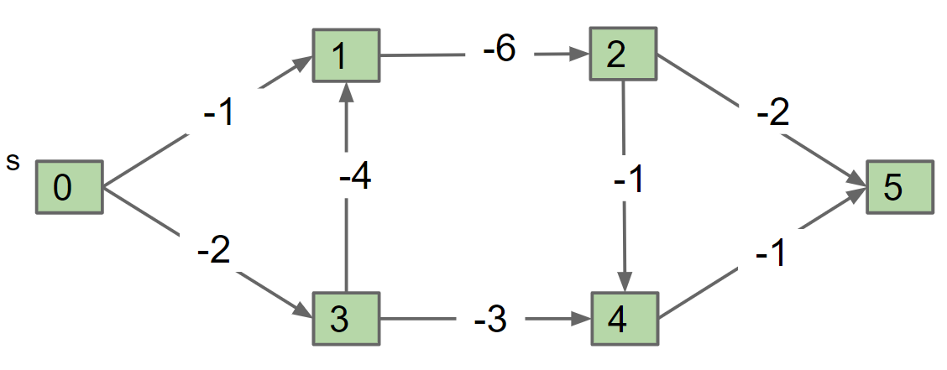
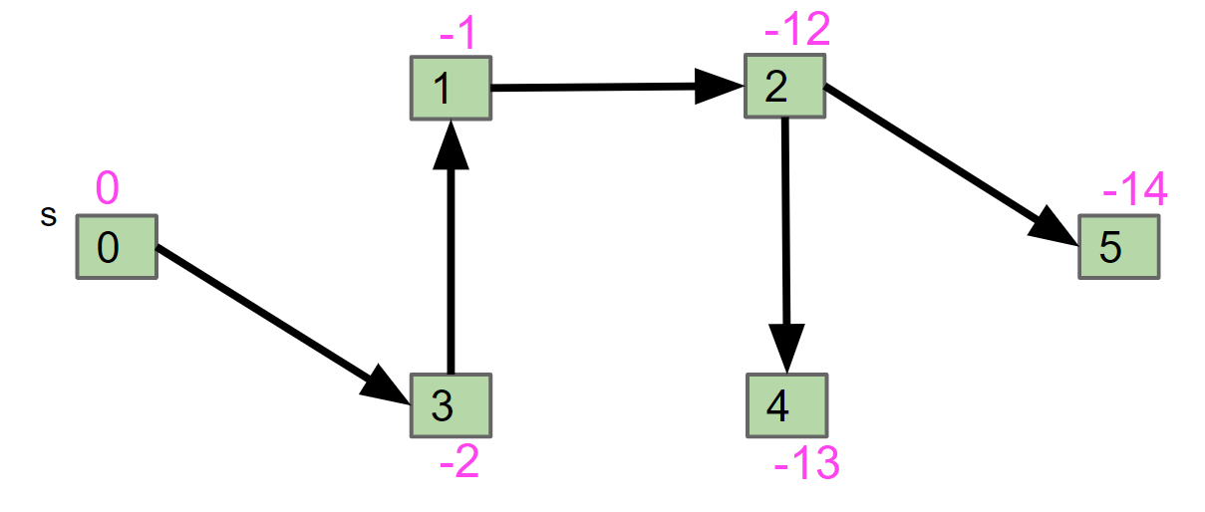
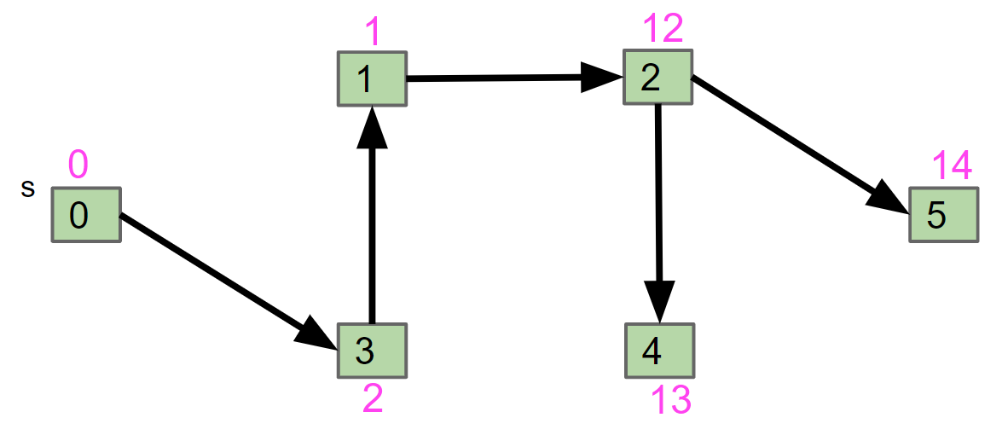
DAG Longest Paths
The problem solving we just used probably felt a little different than usual:
Given a graph G, we created a new graph G’ and fed it to a related (but different) algorithm, and then interpreted the result.
DAG-LPT
G
G’
Preprocess
DAG-SPT
SPT of G’
LPT of G
Postprocess

Slide 53
Reduction
This process is known as reduction.
Since DAG-SPT can be used to solve DAG-LPT, we say that “DAG-LPT reduces to DAG-SPT”.
DAG-LPT
G
G’
Preprocess
DAG-SPT
SPT of G’
LPT of G
Postprocess

Slide 54
Reduction Analogy
This process is known as reduction.
Since DAG-SPT can be used to solve DAG-LPT, we say that “DAG-LPT reduces to DAG-SPT”.
As a real-world analog, suppose we want to climb a hill. There are many ways to do this:
“Climbing a hill” reduces to “riding a ski lift.”
“Climbing a hill” reduces to “being shot out of a cannon.”
“Climbing a hill” reduces to “riding a bike up the hill.”

Slide 55
Reduction Definition (Informal)
This process is known as reduction.
Since DAG-SPT can be used to DAG-LPT, we say that “DAG-LPT reduces to DAG-SPT”.
Algorithms by Dasgupta, Papadimitriou, and Vazirani defines a reduction informally as follows:
“If any subroutine for task Q can be used to solve P, we say P reduces to Q.”
Can also define the idea formally, but way beyond the scope of our class.
If you’re curious, you can read more about Karp and Cook reductions.
Reduction is more than sign flipping. Let’s see a richer example of a reduction.

Slide 56
Reductions: Definition
Topological Sorting
Shortest Paths on DAGs
Longest Paths
Reductions
Definition
Reduction to 3SAT (Optional CS170 Preview)
Lecture 26, CS61B, Spring 2024

Slide 57
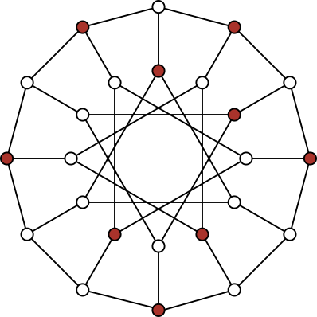
The Independent Set Problem
An independent set is a set of vertices in which no two vertices are adjacent.
The Independent-set Problem:
Does there exist an independent set of size k?
i.e. color k vertices red, such that none touch.
Example for the graph on the right and k = 9
For this particular graph, N=24.

Slide 58
The 3SAT Problem
3SAT: Given a boolean formula, does there exist a truth value for boolean variables that obeys a set of 3-variable disjunctive constraints?
3 variable disjunctive constraint
Example: (x1 || x2 || !x3) && (x1 || !x1 || x1) && (x2 || x3 || x4)
Solution: x1 = true, x2 = true, x3 = true, x4 = false

Slide 59
3SAT Reduces to Independent Set
Proposition: 3SAT reduces to Independent-set.
Proof. Given an instance ϕ of 3-SAT, create an instance G of Independent-set:
For each clause in ϕ, create 3 vertices in a triangle.
Add an edge between each literal and its negation (can’t both be true in 3SAT means can’t be in same set in Independent-set)
k = number of variables = 4
x1
! x1
! x1
x1
x2
x3
! x2
x4
! x4
x3
x3
x4
Φ = (x1 or x2 or x3) and (! x1 or ! x2 or x4) and (! x1 or x3 or ! x4) and (x1 or x3 or x4)

Slide 60
3SAT Reduces to Independent Set
Find an independent set of size k = 4. Use this set to generate a solution to the 3SAT problem.
Reminder: An independent set of size 4 is a set of 4 (red) vertices that do not touch.
k = number of variables = 4
x1
! x1
! x1
x1
x2
x3
! x2
x4
! x4
x3
x3
x4
Φ = (x1 or x2 or x3) and (! x1 or ! x2 or x4) and (! x1 or x3 or ! x4) and (x1 or x3 or x4)

Slide 61
3SAT Reduces to Independent Set
Find an independent set of size k = 4. Use this set to generate a solution to the 3SAT problem.
Reminder: An independent set of size 4 is a set of 4 (red) vertices that do not touch.
k = number of variables = 4
x1
! x1
! x1
x1
x2
x3
! x2
x4
! x4
x3
x3
x4
Φ = (x1 or x2 or x3) and (! x1 or ! x2 or x4) and (! x1 or x3 or ! x4) and (x1 or x3 or x4)

Slide 62
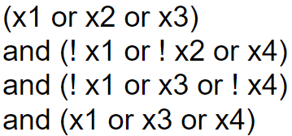
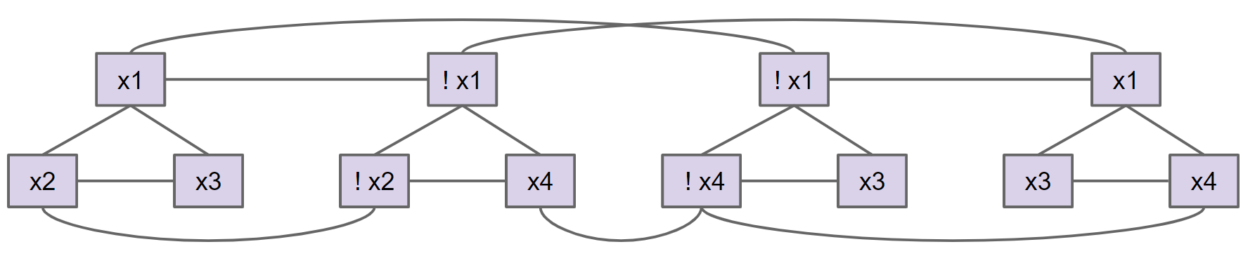
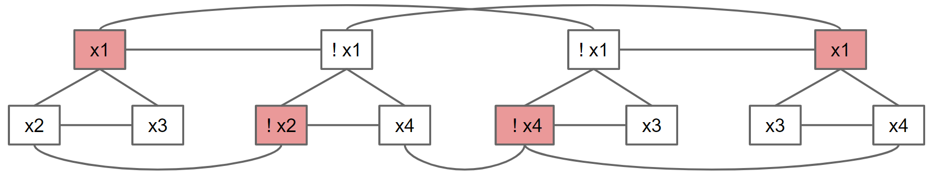
Reduction
Since IND-SET can be used to solve 3SAT, we say that “3SAT reduces to IND-SET”.
Note: 3SAT is not a graph problem!
Note: Reductions don’t always involve creating graphs.
3SAT
Φ
G
Preprocess
IND-SET
Assignment so
that Φ gives true.
Postprocess
x1: true
x2: false
x3: false
x4: true
IND-SET for G

Slide 63
Reductions and Decomposition
Arguably, we’ve been doing something like a reduction all throughout the course.
These examples aren’t reductions exactly.
We aren’t just calling a subroutine.
A better term would be decomposition: Taking a complex task and breaking it into smaller parts. This is the heart of computer science.
Using appropriate abstractions makes problem solving vastly easier.

Slide 64
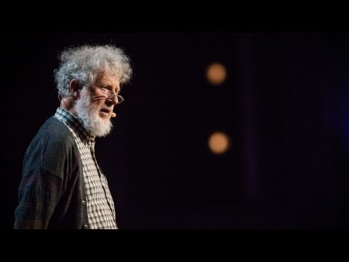
Generational Changes in the Human Mind
Notes:
Slip to 4 minute

